Slide 1
Practical Application of Agile PM Principles

Slide 2
Outline
DSDM Practice : MoSCoW Prioritization
  Introduction
  The MoSCoW Rules
  MoSCow relating to a Specific Timeframe
DSDM Practice : Timeboxing
  Timeboxing Options
  The Daily Stand Up (Scrum)
  Timeboxes - The Wider Context

Slide 3
DSDM Practice : MoSCoW Prioritisation

Slide 4

DSDM Practice - MoSCoW Prioritisation
Must have = Minimum Usable SubseT (Guaranteed)
Without this requirement . no point on this date or not legal or unsafe or not a viable solution
Should have Important but not vital
May be painful to leave out but solution still viable
May need workaround, which may be temporary
Could have Wanted or desirable but less important
Less impact if left out (compared with a Should)
Won't have this time
Will not be delivered in this timeframe

Slide 5
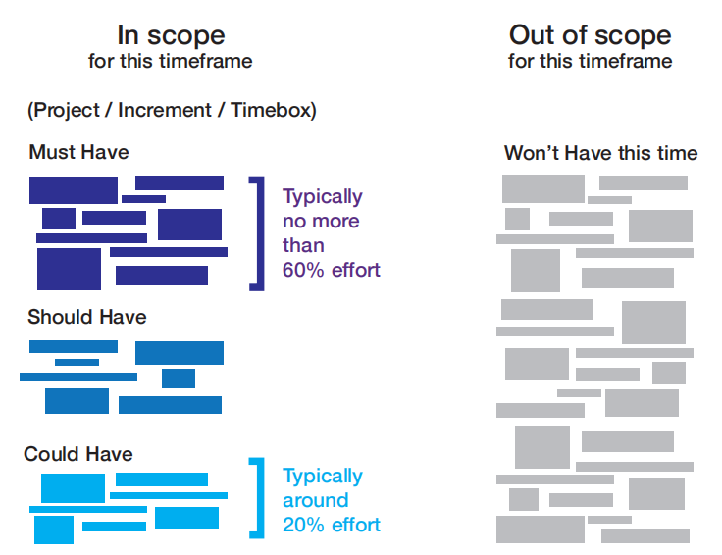
MoSCoW Relating to a Specific Timeframe

Slide 6

Making MoSCoW Work
Agree up-front how priorities will work
- Must Haves non-negotiable
- Should Haves and Could Haves are subjective
- Discussion facilitated by the Project Manager and Business Analyst
Majority of prioritisation starts at Foundations but priorities continually reviewed - they change over time
When new requirements added, check impact
- On project and on balance of MoSCoW effort

Slide 7
Making MoSCoW Work
At end of Increment, all requirements not met are re-prioritised according to the need of the next Increment
Use MoSCoW to manage business expectations
- High % of Should Haves and Could Haves provide optimum contingency to ensure delivery of Must Haves
PM responsible for ensuring Delivery Plan is realistic and achievable

Slide 8

Prioritisation - Who Decides?
Are all Must Haves non-negotiable?
- Must Have = "Deliver this or we cancel the project
- PM or Business Analyst may challenge less obvious Must Haves
- Can this requirement be broken down further?
• A high-level Must may contain a mix of Musts, Shoulds, Coulds, Won'ts
Business Visionary and Ambassador have final say
The Business Sponsor perspective
- Expects all Must Haves
- Typically also expects most / all Should Haves to be delivered
- DSDM's recommended % split gives at least 20% "contingency" for Could Haves
NB 10% contingency is the normal contingency on traditional projects

Slide 9
Assigning Priorities - AgilePM Top Tips
Ensure business roles understand why and how DSDM priorities requirements
Consider starting all requirements as Won't Have, then justify why priority is higher
Question Must Haves
- "If on night before Deployment, this requirement is not ready, would you cancel project?"
- "Is there a workaround, even if it is painful?" If Yes, then it is not a Must
Ask why this requirement is needed? For Project? For Increment?

Slide 10
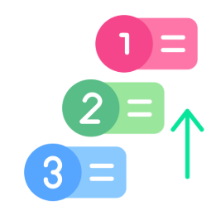
Assigning Priorities - AgilePM Top Tips
Is this requirement dependent on completion of other requirements?
- A Must cannot depend on a Should Have, Could Have or Won't Have
Allow for different priorities of acceptance criteria
Can this requirement be decomposed?
Decomposed elements may have different priorities
Tie requirements to a project objective :
If objective not a Must, then requirement cannot be a Must
MoSCoW helps prevent effort spent on "interesting" rather than "important" things

Slide 11
DSDM Practice : Timeboxing

Slide 12
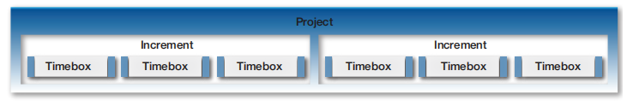
Timeboxes - How Long?
During Foundations, Agile PM helps Solution Development Team agree preferred length of Timebox
Short enough to keep team focused
Long enough to achieve something complete and meaningful
Usually between 2 and 4 weeks
Longer Timeboxes should be avoided unless really necessary

Slide 13
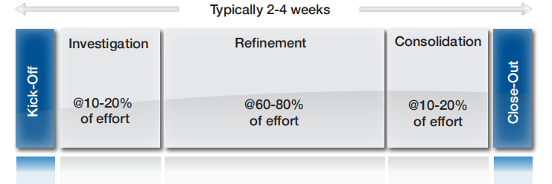


Timeboxing - Which style?
DSDM Structured Timebox
Free Format Timebox

Slide 14
A DSDM Structured Timebox
- Check TB objectives in Delivery Plan still feasible
- Agree acceptance criteria, where possible
- Review availability of SDT members
- Highlight known dependencies
- Sign-off what has been delivered
- Assess impact of what has not been "done"
- Build on good experience
- Avoid repeating same mistakes
- Define issues to be resolved for next TB
- Understand detail and
priorities of work to be done
- Review dependencies,
Timebox Plan and risks
- Work on the Solution in line with agreed MoSCoW priorities
- Review at end of
Refinement (work
should be nearly ready)
- Complete actions from Refinement review
- Complete final testing
- Ensure organisational or project standards have been met, with any final quality checks
- Review at end of Consolidation, ensuring TB objectives are met.
- Any products not meeting acceptance criteria deemed as "Not Delivered"

Slide 15
Timeboxing - Which style?
Reflects style used by other popular Agile approaches e.g. Scrum Sprint
Used when DSDM Structured Timebox not possible or not helpful
Starts with Kick-off and finishes with Close-out
In between, any number of formal or informal review points
SDT pick up one or more products or requirements/User Stories and evolve these iteratively until completed and meet agreed acceptance criteria
SDT then pick up the next product or requirement/User Story and repeat the process
Free format style relies on Business Ambassador being available consistently to review and provide feedback on ongoing basis

Slide 16
Timeboxing - Agile PM Top Tips
Ask "How soon can Tester start testing?" and "When is the earliest we can complete a User Story?" Early completion (within a few days) demonstrates tangible progress
Believe in the TB : encourage SDT to finish on time by prioritising work to be done
Never let TB "overrun"
Insist works stops at agreed time and work out what is "done"
Even if TB has correct balance of priorities, individual skills and capabilities of SDT may still make achieving objectives difficult / impossible

Slide 17

Timeboxing - Agile PM Top Tips
Check TB progress by observing daily Stand-Ups and enabling SDT to react quickly to problems raised
Build environment of trust and no-blame, to ensure SDT are open about progress
Ensure TB Kick-off involves right people
Ensure acceptance criteria for successful TB completion are clear at Kick-off
Ensure key risks affecting TB are identified at Kick-off, and monitored during TB
Ensure Close-out performs a Retrospective to feed learnings into next TBs

Slide 18
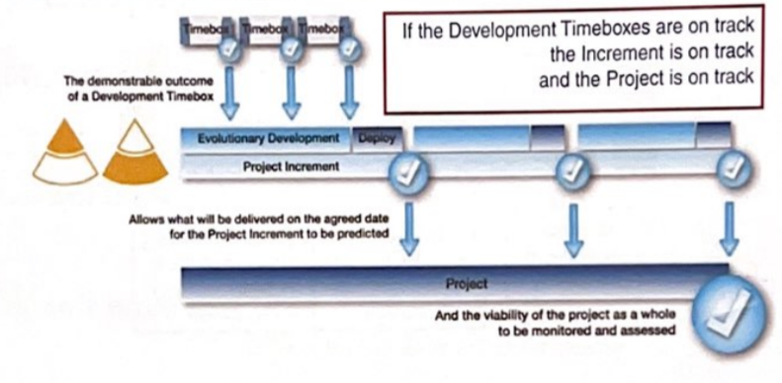
Timeboxing - Which style?
Combining Timeboxing with MoSCoW enables consistent and predictable on-time delivery of projects
Project and Increment delivery founded on delivery of Development TBs
Development Timeboxes:
- Provide control at lowest level - on-going validation of Delivery Plan
- Provide clear indication of project health
- Prove estimating is working (or quickly highlight if not working)
- Prove SDT is working effectively (or quickly highlight if not effective)
Confidence feeds upwards to Increment and Project levels

Slide 19
MoSCoW - Integral Part of Planning Process
Getting sensible MoSCoW balance at Project and Increment levels achieved through collaboration between whole team
- Business roles work together
•To ensure priorities reflect true business needs
• To group requirements to provide effective and valuable solution to meet business deadlines
- Solution / Technical roles work together
• To ensure plans to deliver these priorities are realistic, achievable reflect any technical constraints and are being planned in most efficient way

Slide 20
MoSCoW - Integral Part of Planning Process
- Business Analyst
• Considers links between requirements and availability of information
• Helps to identify viable groups of requirements
- Agile Project Manager
• Ensures balance of priorities reflects level of known risks on this specific project

Slide 21
The Daily Stand-up and the AgilePM
Opportunity for Solution Development Team
- To share information
- To carry out day-day re-planning and re-organising
This is in addition to daily ongoing informal SDT communication
Agile PM regularly attends, primarily as observer
- To understand progress and pick up on escalated issues
- But always remember Stand-up is run by SDT and for SDT
• They are not "Reporting" to PM
Visionary and Technical Coordinator also observe to keep in touch with progress
- Visionary is also providing visible ongoing support
- Technical Coordinator is keeping up with technical decisions and picking up escalated technical issues

Slide 22
The Daily Stand-up and the AgilePM
A key part of all Timeboxes
Takes place same time, same place every day
SDT share information to enable any day-to-day replanning and reorganising
Simple format
1. What I have done since the last stand-up to help achieve the Timebox objectives?
2. What I will be doing until the next stand-up to help achieve the Timebox objectives?
3. What problems, risks or issues (blockers) do I have that will prevent me or the team achieving the Timebox objectives?
As a guide, allow 2 minutes per person + 2 minutes

Slide 23
Empowered Teams and Change in Timeboxes
SDT must be appropriately empowered to handle any change falling within agreed TB objectives without formal change control
- i.e. without needing to go outside SDT
As a guide, following scenarios mean change of scope and therefore need to be handled more formally (outside the SDT)
- Changing breadth of solution
• Adding to high level requirements
• Removing Must Have requirements (Increment or Project Level)
- Increasing % of Must Haves
• By adding new Musts or upgrading Won'ts, Coulds or Shoulds to Must Have
SDT always empowered to operate within previously agreed boundaries without need to escalate to PM

Slide 24
Timeboxing - The Wider Context

Slide 25

Questions on Prioritisation and Timeboxing ?

Slide 26
EXERCISES
In a DSDM project, what does the W' in 'MoSCoW' stand for?
a) Want this
b) Won't have this time
c) Would have
d) Wish list
In a structured Timebox when does the Solution Development Team seek to understand the
Timebox objectives and accept them as realistic?
a) Investigation
b) Kick-Off
c) Consolidation
d) Refinement

Slide 27
EXERCISES
3. Which approach correctly reflects the use of MoSCoW prioritisation?
a) Relates to a specific timeframe
b) Applied and fixed during Foundations
c) Only applied at project level
d) Is optional
4. How often should a Timebox Plan be updated?
a) Hourly
b) Daily
c) Weekly
d) Monthly

Slide 28
EXERCISES
5. Under the DSDM MoSCoW rule, which definition describes the Must Have requirement?
a) Important but not vital
b) Solution not viable without it
c) Painful to leave out
d) May need some kind of workaround
6. How long should the Daily Stand-up take?
a) As long as it takes
b) Fifteen minutes per participant
c) No more than half an hour
d) Two minutes per participant, plus two minutes

Slide 29
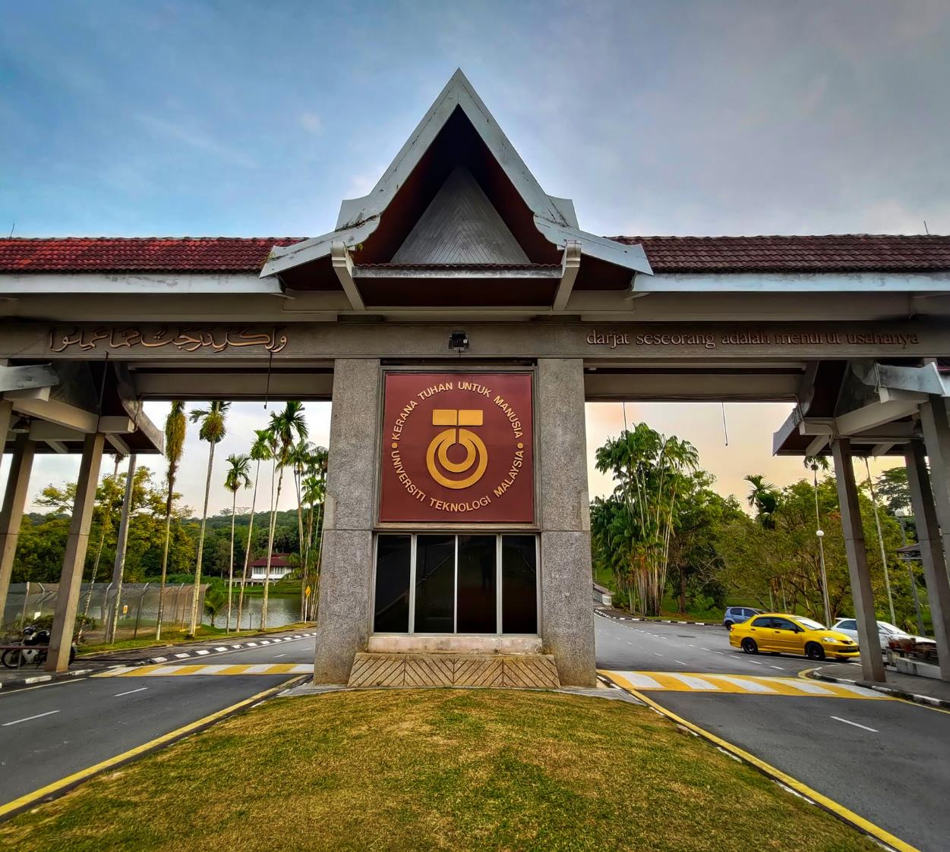






THANK YOU
In the Name of God for Mankind
www.utm.my

